Slide 1


João Marcos P. P. Salles
08/04/2023

Slide 2

Outline
Executive Summary
Introduction
Methodology
Results
Conclusion
Appendix

Slide 3
Executive Summary
For this project we used two methods of data collection: direct connection with the SpaceX Falcon 9 data API and data wrangling from the Wikipedia pages.
After the data collection phase, we proceeded with the wrangling phase where the data was checked and prepared for the visualization phase and predictive models ahead.
In the next phase we uploaded the data set to a larger database where we could perform exploratory SQL analysis and the proceed to the visualization phase.
In the visualization phase, we’re able to check the validity, in a visual format, of the database in various forms and how it can impact the predictive models, while plotting them on various forms with various advanced graphic libraries.
Finally, we pass to the predictive modelling phase, where we test several models checking their accuracy and deciding on the best one to use to answer our questions.
Github link to all Jupyter notebooks and files: https://github.com/jmppsalles/IBM_Capstone

Slide 4
Introduction
Project background and context
Space X advertises Falcon 9 rocket launches on its website with a cost of 62 million dollars; other providers cost upward of 165 million dollars each, much of the savings is because Space X can reuse the first stage. Therefore, if we can determine if the first stage will land, we can determine the cost of a launch. This information can be used if an alternate company wants to bid against space X for a rocket launch. This goal of the project is to create a machine learning pipeline to predict if the first stage will land successfully.
Problems you want to find answers
What factors determine if the rocket will land successfully?
The interaction amongst various features that determine the success rate of a successful landing.
What operating conditions needs to be in place to ensure a successful landing program.

Slide 5


Slide 6
Data Collection
The data was collected using various methods
Data collection was done using get request to the SpaceX API and normalized into a pandas Dataframe;
Additional data was gathered by web scraping the Wikipedia page for Falcon 9 launch records with BeautifulSoup;
We then cleaned the data, checked for missing values and fill in missing values where necessary;
Finally, we saved the data on a .csv file for future use.
All files are saved on GitHub @ https://github.com/jmppsalles/IBM_Capstone

Slide 7
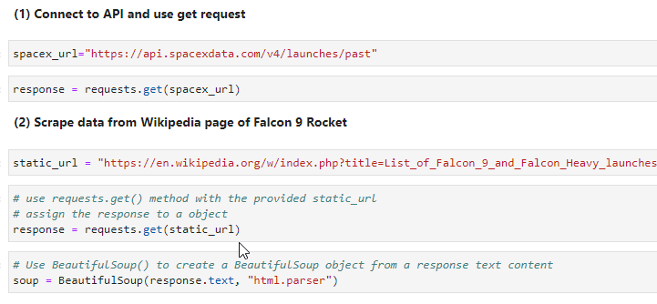
Data Collection – SpaceX API and Webscraping
We used the get request to the SpaceX API to collect data, clean the requested data
Used BeautifulSoup to scrape data from Wikipedia page of the Falcon 9.

Slide 8
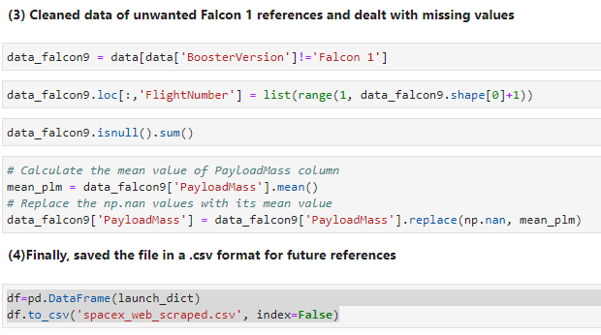
Data Collection – Data Wrangling
Cleaned and wrangled data to a format that would be used in the later phases of data visualization and predictive analysis.
Saved the data in a .csv format for future use.

Slide 9
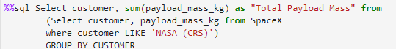
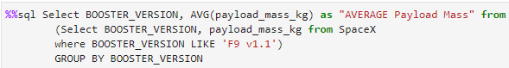
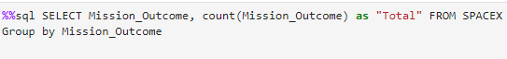
Insights from Queries with SQL
We loaded the SpaceX dataset into the IBM SQL database by way of the Watson jupyter notebook interface
We applied several SQL queries to get some insight:
The names of unique launch sites in the space mission.
The total payload mass carried by boosters launched by NASA (CRS)
The average payload mass carried by booster version F9 v1.1
The total number of successful and failure mission outcomes
List the names of the booster versions which have carried the maximum payload mass.

Slide 10

Visual Analytics
Using the Numpy, Seaborn and Matplotlib libraries, we performed exploratory data analysis and determined the training labels.
We calculated the number of launches at each site, and the number and occurrence of each orbits (Low, Middle, High and Geosynchronous Earth Orbits)
We then created a landing outcome label from outcome column and exported the results to a .csv file.
We explored the data by visualizing the relationship between flight number and launch Site, payload and launch site, success rate of each orbit type, flight number and orbit type, the launch success yearly trend.

Slide 11
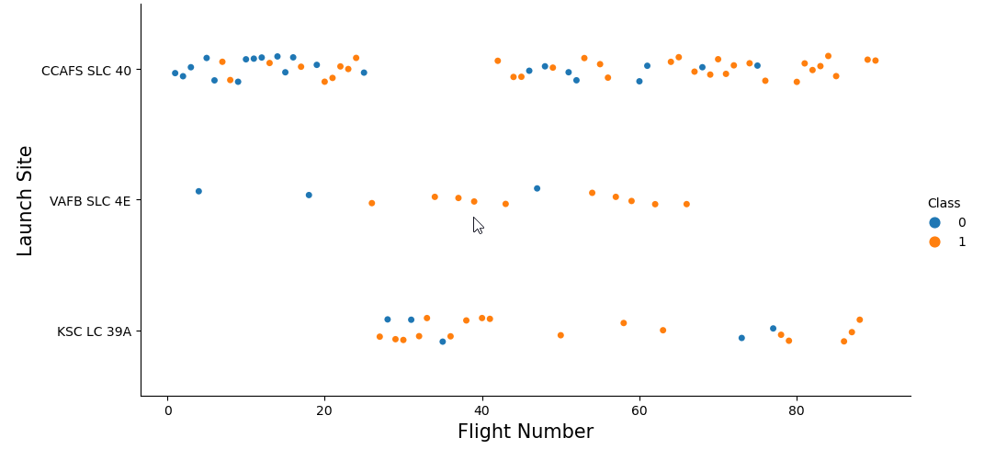
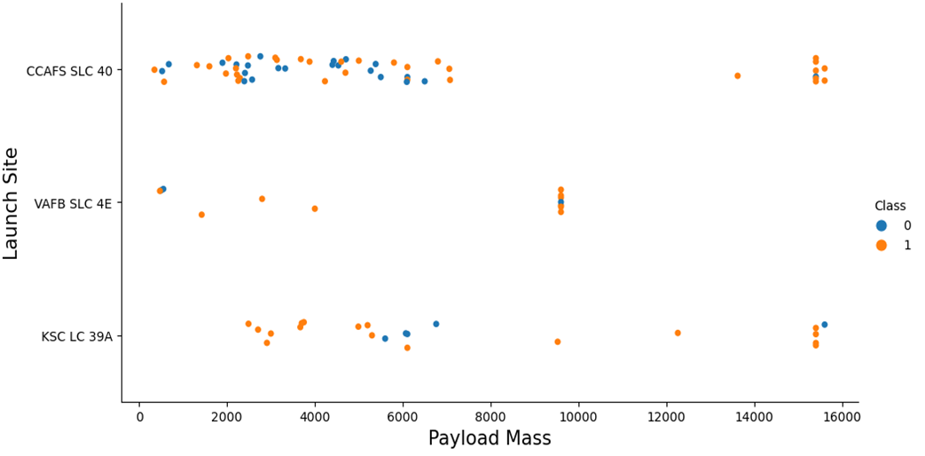
EDA with Data Visualization
The result shows launch site CCFAS SLC 40 with a higher rate of success on lower and higher payloads, whereas KSC LC 39A has more success on middle range payloads.

Slide 12
Building an interactive map with Folium
After getting the geolocation markers for all the launch sites with the provided .csv file (spacex_launch_geo.csv), we also added the NASA JSC coordinates;
Using the Folium library, we created a map where we marked all sites with each specific success or failure assigned to a 1 or a 0 (we also assigned green and red to the successes and failures respectively);
Using these color-labeled marker clusters, we identified which launch sites have relatively high success rate.
We calculated the distances between a launch site to its proximities. We answered some question for instance:
Are launch sites near railways, highways and coastlines.
Do launch sites keep certain distance away from cities.

Slide 13
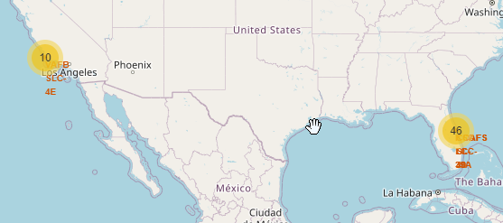
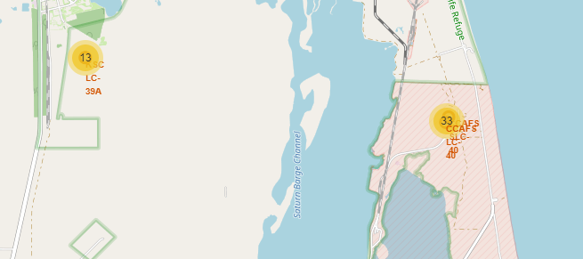
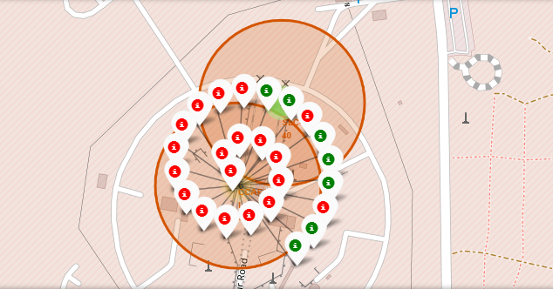
Building an interactive map with Folium (cont.)
Interactive maps:

Slide 14
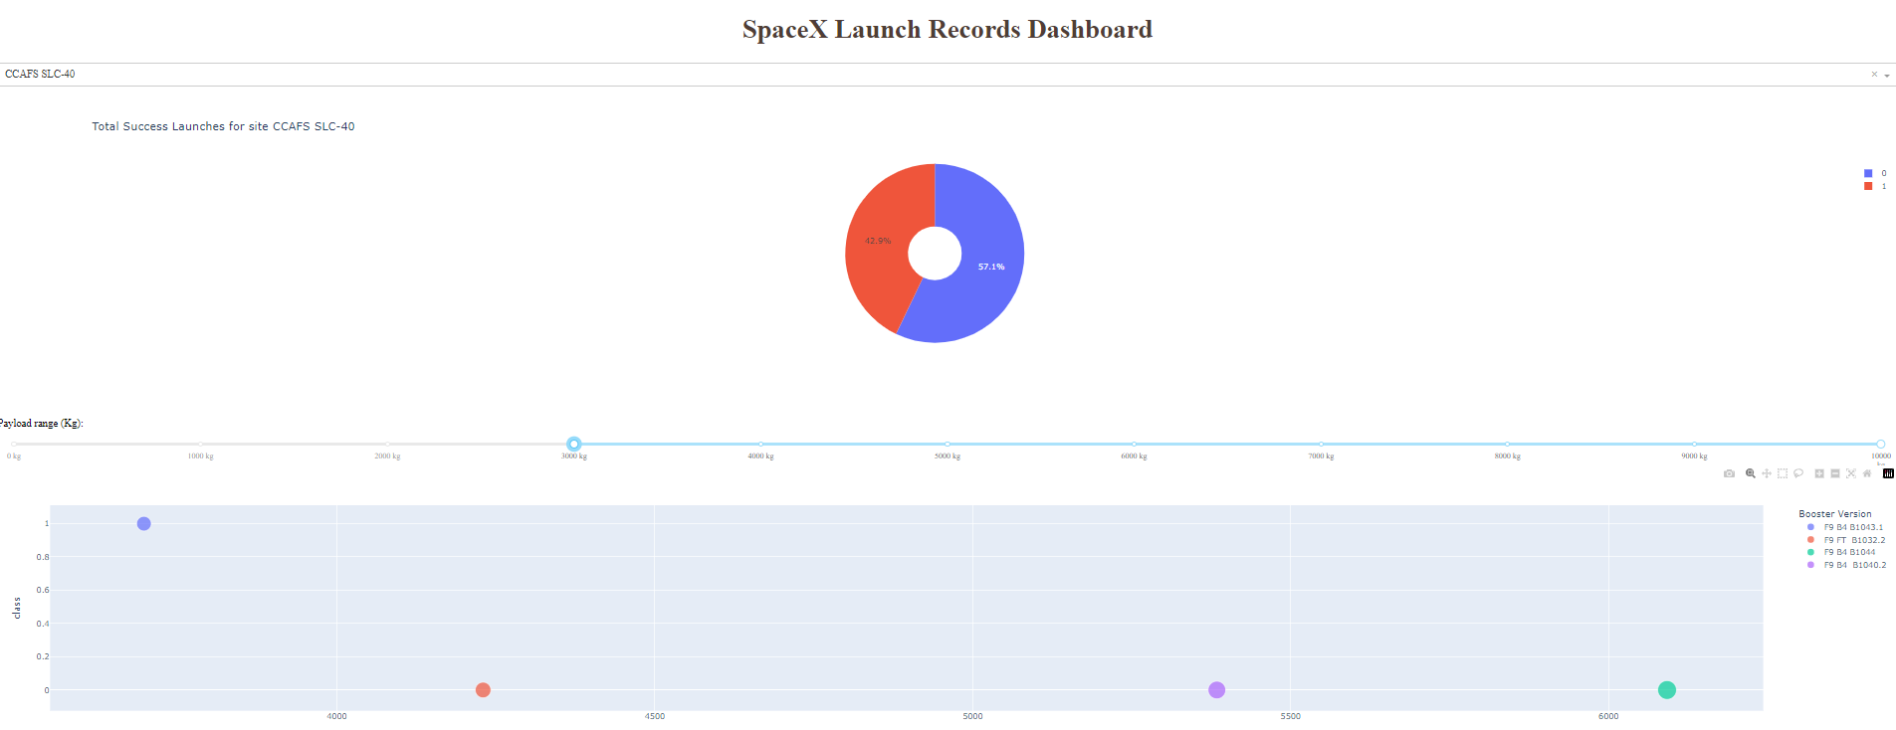
Build a Dashboard with Plotly Dash
We built an interactive dashboard with Plotly dash
We plotted pie charts showing the total launches by a certain sites
We plotted scatter graph showing the relationship with Outcome and Payload Mass (Kg) for the different booster version.

Slide 15
Predictive Analysis (Classification)
Using Pandas, Numpy, Matplotlib, Pyplot, Seaborn and Sklearn, we standardized the data, split it into training and testing sets.
We chose the following predictive models to test: Logistic Regression (LogReg), K Nearest Neighbor (KNN), Decision Tree (Tree) and Support Vector Machine (SVM)
We used accuracy as the metric for our model, improved the model using feature engineering and algorithm tuning.
We found the best performing classification model.

Slide 16
Results
Exploratory data analysis results
Interactive analytics demo in screenshots
Predictive analysis results

Slide 17


Slide 18

First Successful Ground Landing Date
From the Data gathered, we found that the first successful landing happened on December 22nd, 2015.

Slide 19

Total Payload Mass
Total payload carried for NASA is 45.6 tonnes.

Slide 20

Average Payload Mass by F9 v1.1
Average payload mass carried by Falcon9 v1.1 is 2,928.4 Kg

Slide 21

Successful Drone Ship Landing with Payload between 4000 and 6000
These are the successful booster landings on drone ships, with mass between 4,000 and 6,000 Kg

Slide 22

Boosters Carried Maximum Payload
The maximum payload for the Falcon 9 B5 booster subtypes is 15,600 Kg.

Slide 23
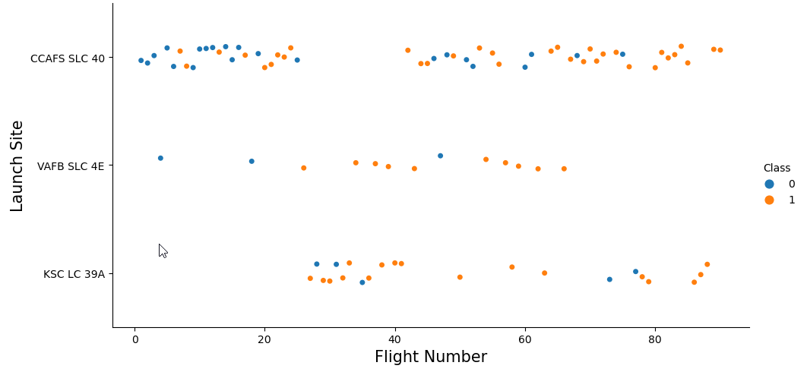
Flight Number vs. Launch Site
From the plot, we found that the larger the flight amount at a launch site, the greater the success rate at a launch site.

Slide 24
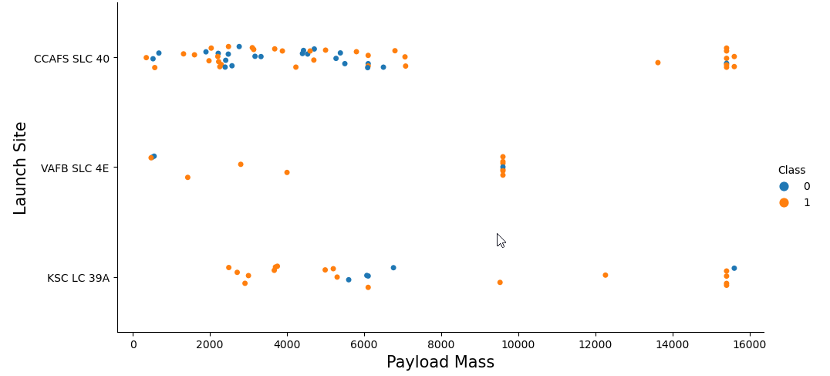
Payload vs. Launch Site
The higher the payload, the higher the chance for a successful landing
Launch site CCAFS SLC 40 has the higher rate of successful rate of landings per payload mass.
Together with the previous slide, we can come to the conclusion that launch site CCAFS SLC 40 is preferable to the other sites.

Slide 25
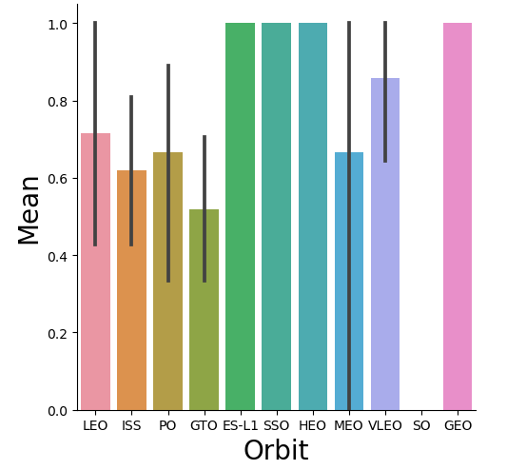
Success Rate vs. Orbit Type
From this graph, we can conclude that missions targeting ES-L1, GEO, HEO, SSO, VLEO had the most success rate.

Slide 26
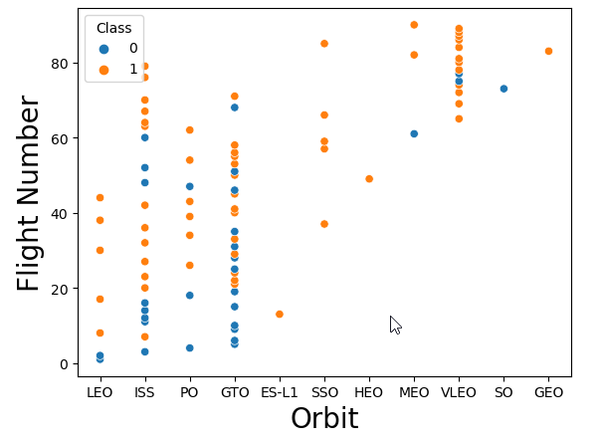
Flight Number vs. Orbit Type
The graph below shows the Flight Number vs. Orbit type. Here we can see that in the VLEO and LEO orbit the Success appears related to the number of flights; on the other hand, there seems to be no relationship between flight number when in GTO orbit.

Slide 27
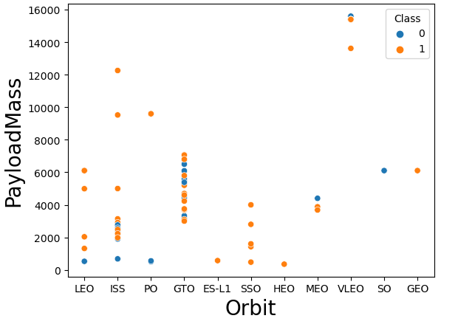
Payload vs. Orbit Type
We can observe that with heavy payloads, the successful landing are more for PO, LEO and ISS orbits.

Slide 28
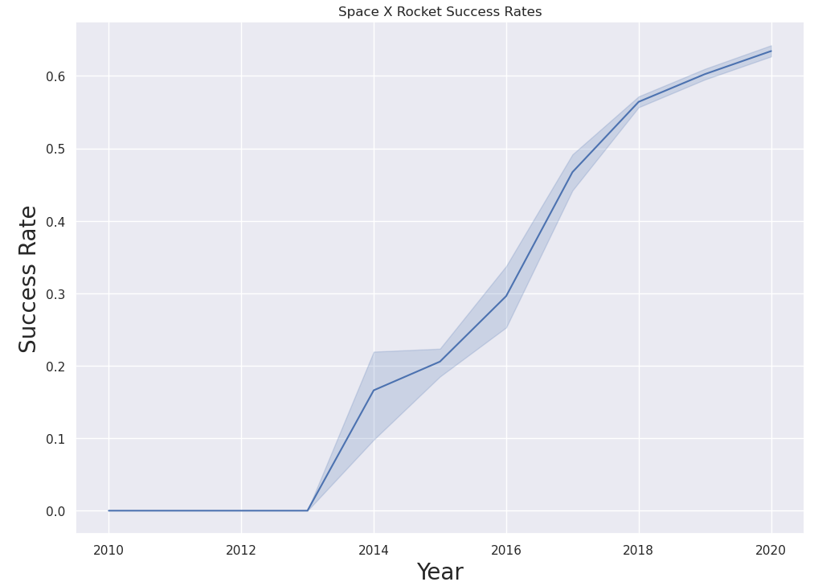
Launch Success Yearly Trend
From this graph, we can observe that success rate since 2014 kept on increasing until 2020, more than tripling in that period

Slide 29


Slide 30
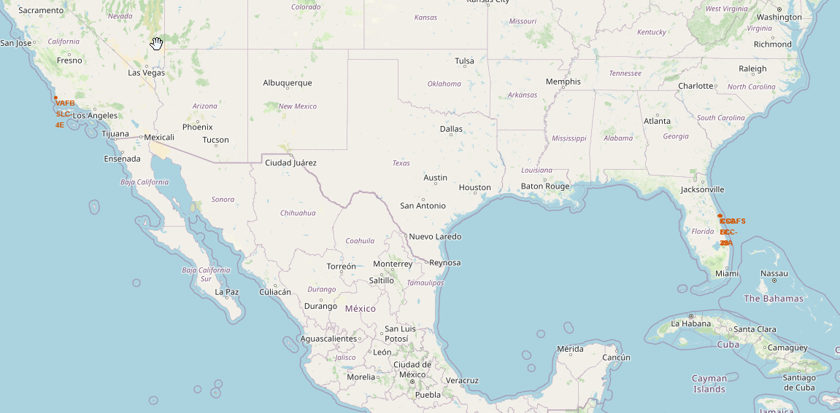
All launch sites map markers
Launch sites situated on both coasts

Slide 31

Markers showing launch sites with color labels

Slide 32


Slide 33
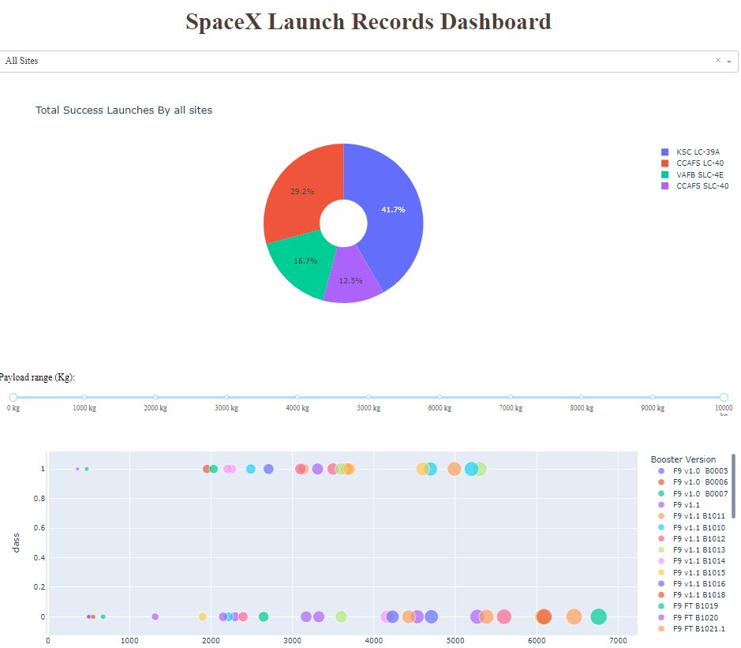
Complete dashboard showing all sites success rate and payload range

Slide 34
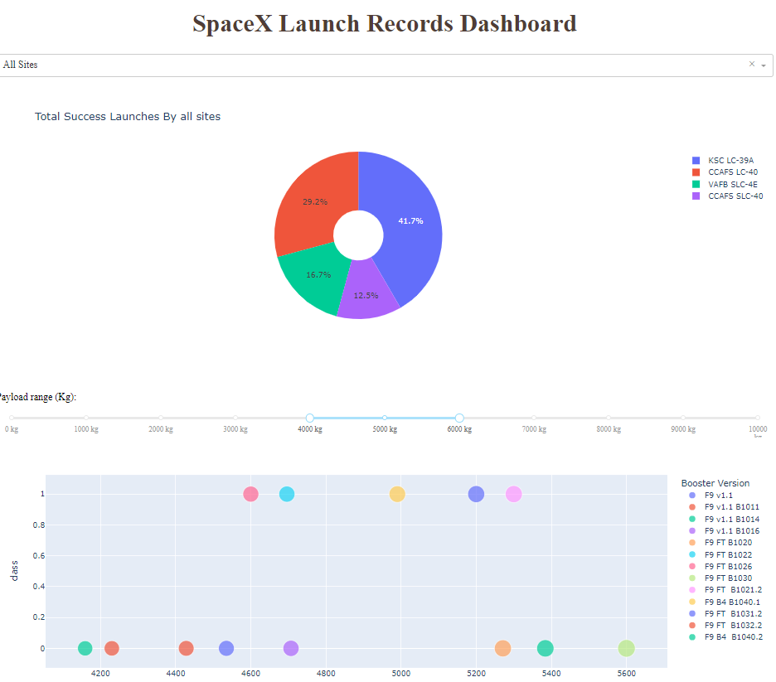
Complete dashboard for all sites with payload between 4,000 and 6,000 Kg

Slide 35

Scatter plot of Payload vs Launch Outcome for all sites, with different payload selected in the range slider

Slide 36
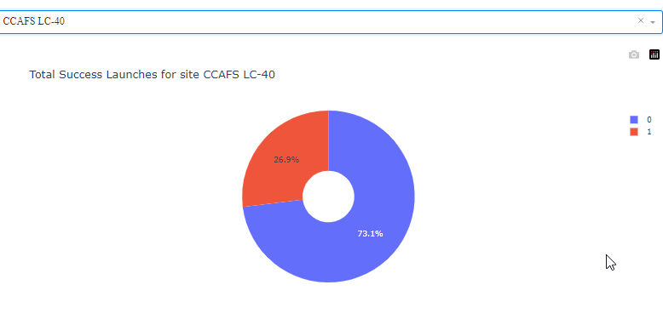
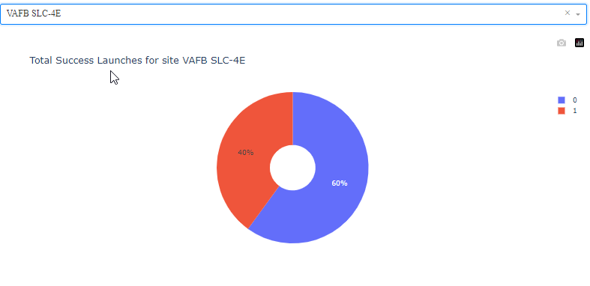
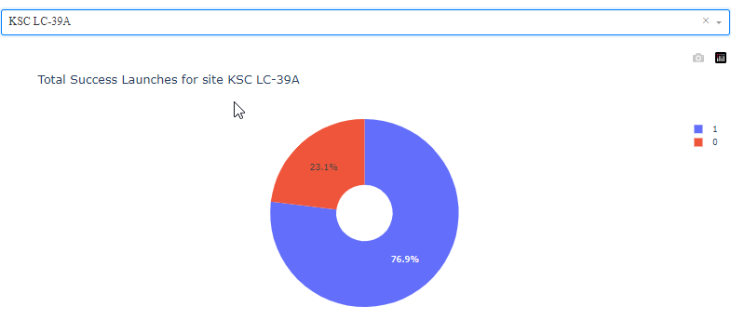
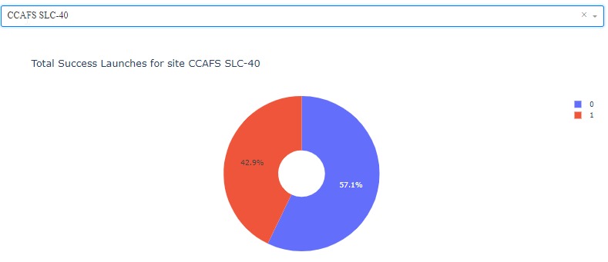
Pie chart comparison of the four launch sites success rates.

Slide 37


Slide 38
Predictive Analysis
Predictive Models
The models chosen for this analysis are:
Logistic Regression (LogReg)
K Nearest Neighbor (KNN)
Decision Tree Classifier (Tree)
Support Vector Machine (SVM)
We split the data in train and test sets with a test size of 0.2 and random state of 0.2.
Result shape of 18 samples.

Slide 39
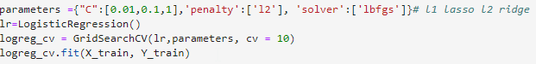
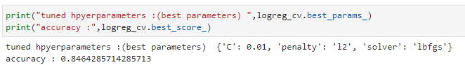
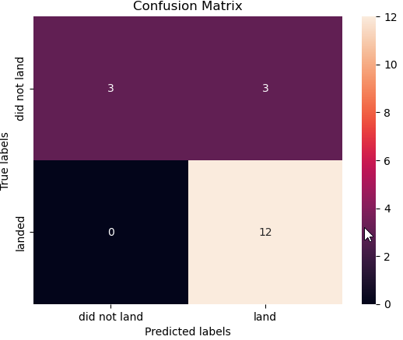
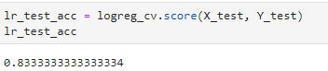
Predictive Analysis
Logistic Regression (LogReg)
Using the following parameters:
We arrived at:

Slide 40
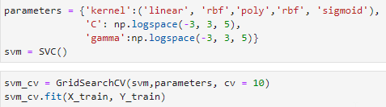
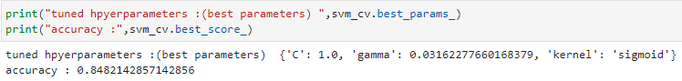
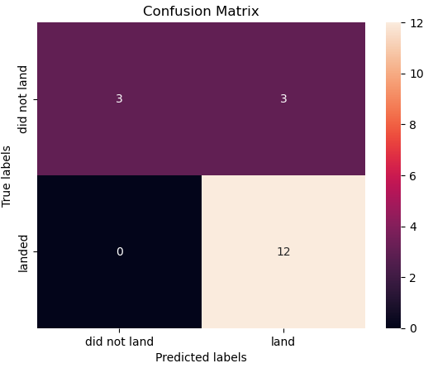
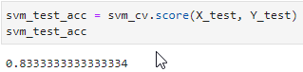
Predictive Analysis
Support Vector Machine (SVM)
Using the following parameters:
We arrived at:

Slide 41
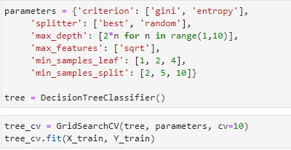
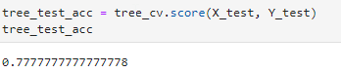
Predictive Analysis
Decision Tree Classifier (Tree)
Using the following parameters:
We arrived at:

Slide 42
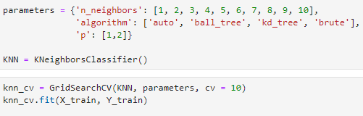
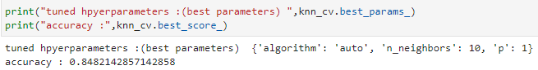
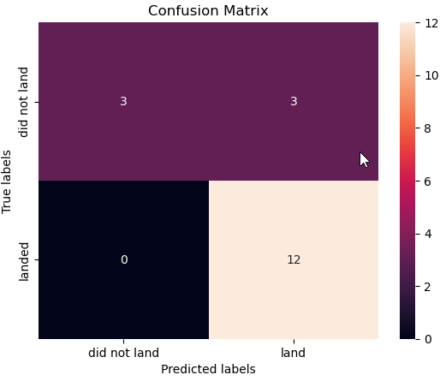
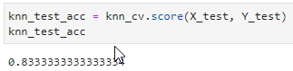
Predictive Analysis
K Nearest Neighbor (KNN)
Using the following parameters:
We arrived at:

Slide 43
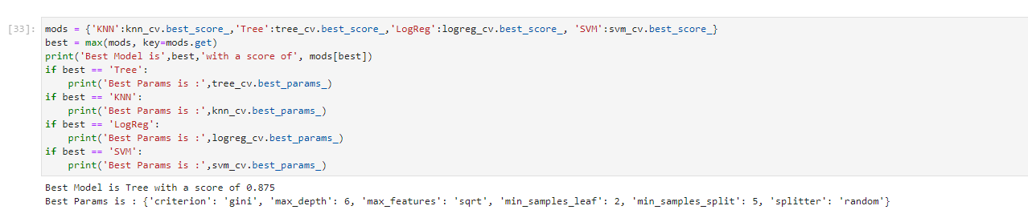
Classification Accuracy
The decision tree classifier is the model with the highest classification accuracy

Slide 44

Confusion Matrix
We can see that all Confusion Matrices have pretty much the same numbers as the accuracy of the four models is very similar.
The confusion matrix for the decision tree classifier shows that it can distinguish between the different classes. The major problem is the false positives .i.e., unsuccessful landing marked as successful landing.

Slide 45
Conclusions
We can conclude that:
The larger the flight amount at a launch site, the greater the success rate at a launch site.
Preferable launch site is CCFS SLC-40, with the higher success landing rate;
Launch success rate started to increase in 2014 and more than triples up to 2020;
Orbits ES-L1, GEO, HEO, SSO, VLEO had the most success rate.
The Decision tree classifier is the most suitable predictive model for this task.

Slide 46


